Slide 1
Agile Business Analysis
A Course from ThoughtWorks
This work is licensed under the
Creative Commons Attribution-ShareAlike 4.0 International License.
To view a copy of this license, visit http://creativecommons.org/licenses/by-sa/4.0/.
Notes:
Hello, and welcome to The Origins of Agile Software Development, a module in Agile Fundamentals. This module is brought to you by ThoughtWorks Studios, makers of Mingle, Go, and Twist.

Slide 2
Introductions
Who are you?
What do you do?
Your agile experience?

Slide 3
About ThoughtWorks
Source: Forrester
Notes:
TIMING: <= 2 Minutes
Introduce TW. 80% of our book is custom software delivery to Global 1000 clients. This training presents ThoughtWorks’ software development techniques, which combine the best of Lean, Scrum, and XP, but put an additional pragmatic stress on the need for BAs, and the role they play.
There is no objective, industry standard way of measuring software delivery efficiency – people have been trying and disagreeing for years.
We do however ask Forrester to take an independent view of the projects we have delivered and compare us to benchmarks that they develop.
The results are quite remarkable – in some ways they should be looked at sceptically as the benchmarks are questionable but they are an indication of the levels of improvement you can get across the time, effort and quality axis that are possible.
Note: you need to be conversant with this report or have it to hand to be able to talk to these metrics.
Improved time to beneﬁt by 69%
Reduced effort by 62%
Reduced critical defects by nearly 80%
Reduced cost by 57%
Reduced defects by more than 60%
re than 2 minutes – quick background, relevant experience

Slide 4
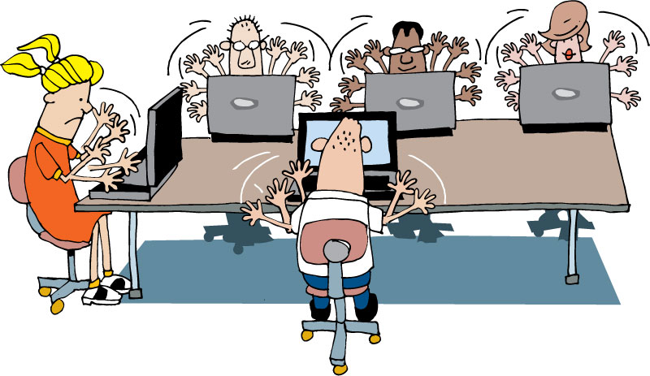
Housekeeping
Mobile phones
Laptops
Break times
Restrooms
Emergencies
Notes:
Please silence mobile phones.
Please close laptops. We have provided workbooks for taking notes.
We will have a break in the morning, lunch and a break in the afternoon. I’ll talk about these more when we talk about the agenda.
Restrooms are……
In case you have an emergency or need to leave early, please do so. Its fine.

Slide 5

Intended Audience
Previous BA experience
Little or no practical agile experience
Good at receiving feedback
Learns quickly
Adaptable to change
Notes:
has previous experience as a BA or another role on a software development project using non agile methodologies
has little or no practical agile experience. Has some knowledge of the processes and practices of agile software development. Maybe heard that agile will make things go quicker and has little documentation.
Good at receiving feedback, encourages it
Learns quickly
Adaptable to change

Slide 6
Course Overview
Opening
Introduction to Agile Analysis
Project Vision & Business Objectives
Understanding the Business Domain
Requirements aka Stories
Estimation & Release Planning
Iteration Level Analysis
Analysis Challenges
Advanced Topics
Notes:
We use a card wall to track our progress in the workshop, just like we do in our projects.
We typically will run 90 minutes in the morning, take a 15 min break and go another 90 minutes and take a lunch break.
We will repeat that in the afternoon.
We end day 1 and 2 with a retrospective. We can sometimes reflect and adapt if something is not going well or if we want more or less of something.

Slide 7

Empathy mapping

Slide 8


Why are we here?
Hopes
Concerns
Notes:
This exercise is used to:
Help us understand what you want to get out of the workshop
Identify concerns you may have about the workshop.
Every exercise we do
Teaches a topic
Informs the participants and/or trainers
Teaches you an exercise to use later. This exercise can be used at the beginning of a project to highlight goals and risks for the project.
Capture hopes and concerns about
the course and/or
the organization’s adoption of Agile.
Agile business analysis
TIMING: 3 – 5 minutes

Slide 9
Other Techniques
Six Thinking Hats
Speed boat
Hot air balloon
Notes:
Other techniques for:
Drawing out risk
Understanding where folks heads are
Identifying potential participant challenges

Slide 10
Agile is not…
…building dependent pieces of an application independently
Notes:
Incremental - we build up our product in increments. We start with a base of core functionality, build the MVP and add features.
Iterative – we iterate our tasks/process – analysis, design, development, test, deploy. Over and over again.

Slide 11
Agile is…
Adaptive
Evolutionary
Collaborative
Just-in-time
Notes:
Adaptive way of managing software development projects
Highly evolutionary and collaborative process
Just-in-time (JIT) basis
Start with a fully formed solution

Slide 12
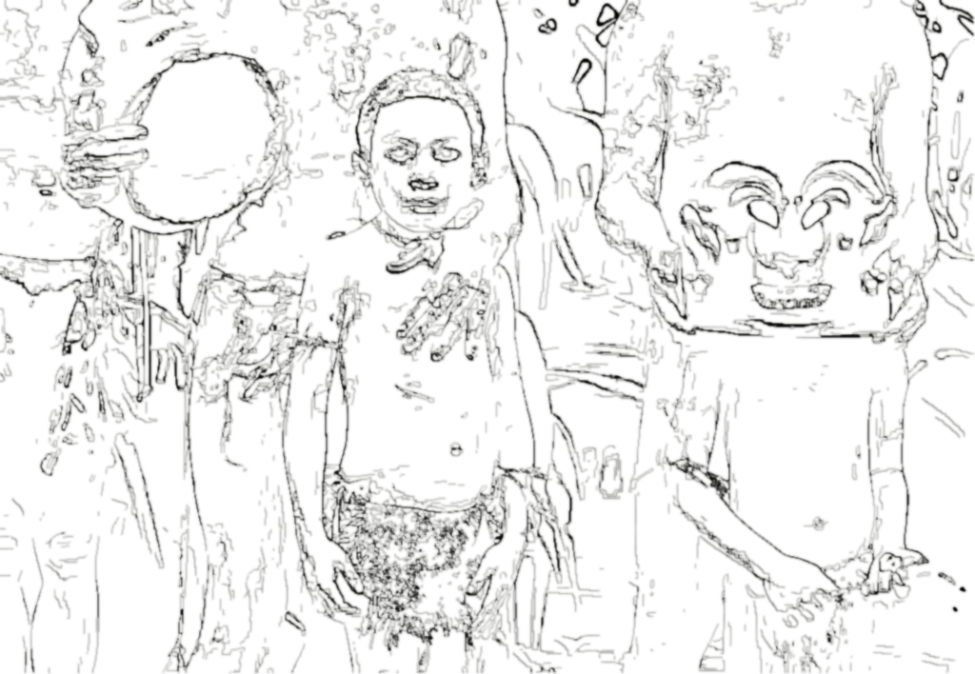
Notes:
NOTE: this slide and the next three have a nice, smooth transition showing graphically how it evolves.
Start with a high level sketch/design.

Slide 13

Notes:
Add a layer of texture/functionality across the whole process.

Slide 14

Notes:
Add a bit more detail, functionality.

Slide 15

Notes:
Until you have a releaseable product.
Which leads us right into an Introduction to Agile Analysis.
How do we get to that fully formed solution?
And how does the BA contribute/pariticpate?

Slide 16
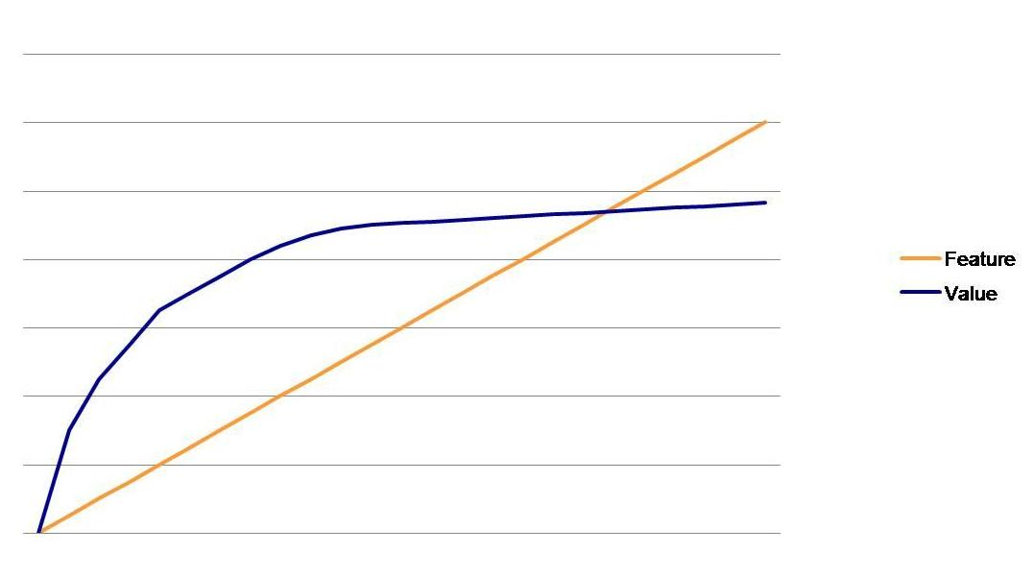
Agile analysis: features prioritized for ROI
Notes:
One responsibility of the BA is to ensure we are delivering value and prioritizing features to drive ROI.
This graph shows a push for value at the beginning of a project and likely a leveling off of value as the we progress through the features requested.
When the customer is engaged, they tend to see the value and cut off projects or deliver early. They discover for themselves that some features may not be needed after all.

Slide 17
Questions?

